Slide 1
Lists
Chapter 8
© 2017 Pearson Education, Hoboken, NJ. All rights reserved

Slide 2
Specifying the ADT List
Things you make lists of
  Chores
  Addresses
  Groceries
Lists contain items of the same type
Operations
  Count items
  Add, remove items
  Retrieve
© 2017 Pearson Education, Hoboken, NJ. All rights reserved

Slide 3
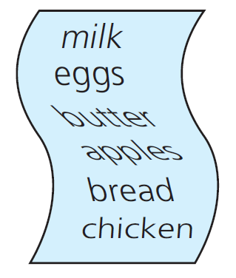
Specifying the ADT List
Figure 8-1 A grocery list
© 2017 Pearson Education, Hoboken, NJ. All rights reserved

Slide 4
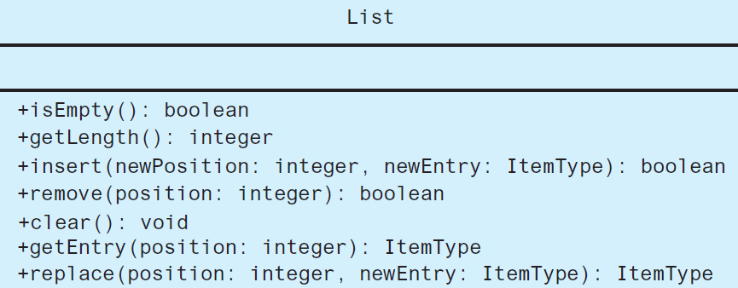
Specifying the ADT List
FIGURE 8-2 UML diagram for the ADT list
© 2017 Pearson Education, Hoboken, NJ. All rights reserved

Slide 5
Specifying the ADT List
Definition: ADT List
  Finite number of objects
  Not necessarily distinct
  Same data type
  Ordered by position as determined by client
© 2017 Pearson Education, Hoboken, NJ. All rights reserved

Slide 6
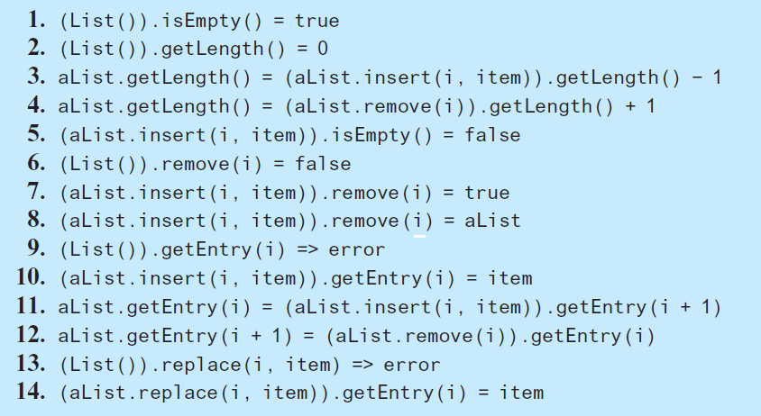
Axioms for ADT List
© 2017 Pearson Education, Hoboken, NJ. All rights reserved

Slide 7
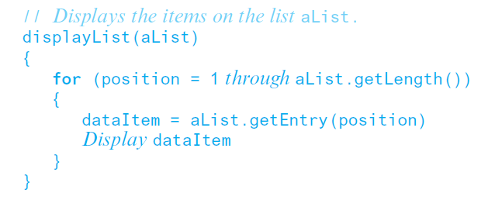
Using the List Operations
Displaying the items on a list.
© 2017 Pearson Education, Hoboken, NJ. All rights reserved

Slide 8
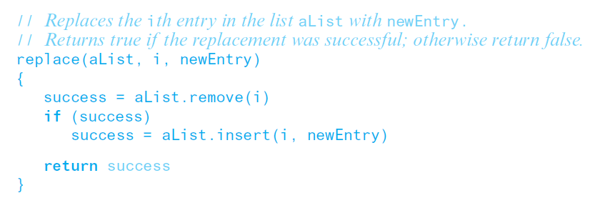
Using the List Operations
Replacing an item.
© 2017 Pearson Education, Hoboken, NJ. All rights reserved

Slide 9
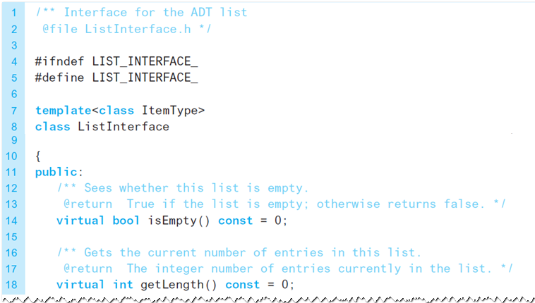
Interface Template for ADT List
LISTING 8-1 A C++ interface for lists
© 2017 Pearson Education, Hoboken, NJ. All rights reserved

Slide 10
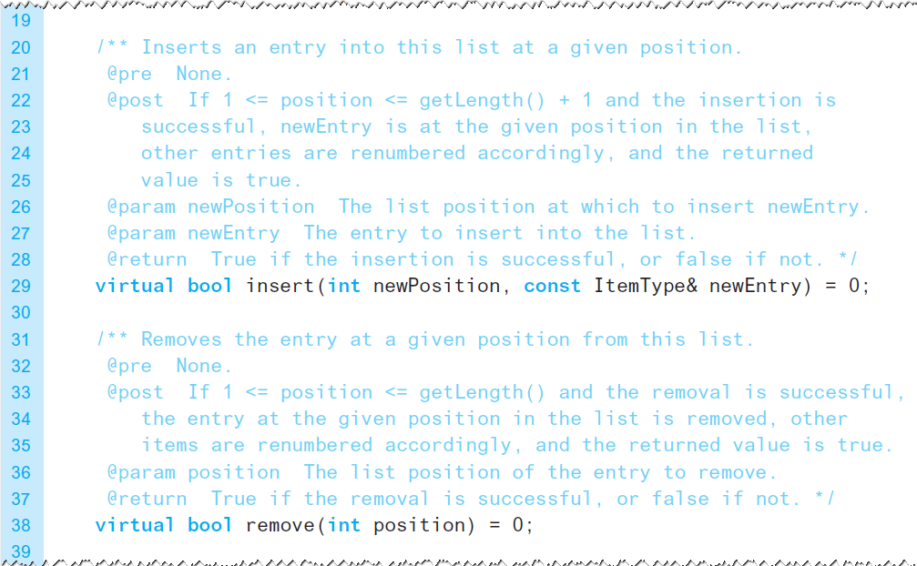
Interface Template for ADT List
LISTING 8-1 A C++ interface for lists
© 2017 Pearson Education, Hoboken, NJ. All rights reserved

Slide 11
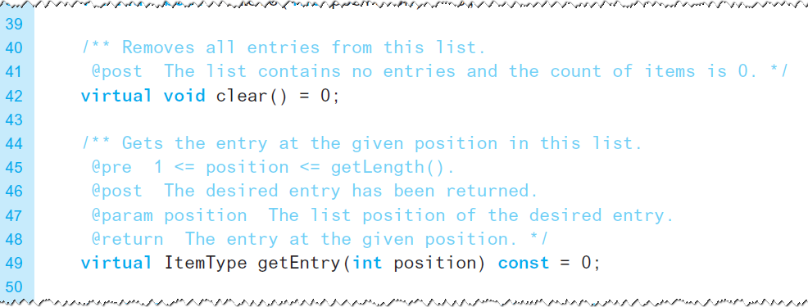
Interface Template for ADT List
LISTING 8-1 A C++ interface for lists
© 2017 Pearson Education, Hoboken, NJ. All rights reserved

Slide 12
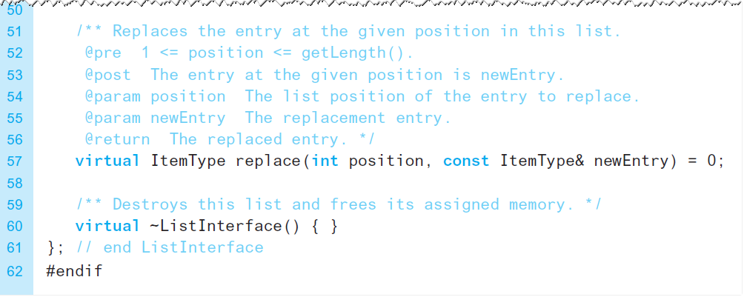
Interface Template for ADT List
LISTING 8-1 A C++ interface for lists
© 2017 Pearson Education, Hoboken, NJ. All rights reserved

Slide 13
End
Chapter 8
© 2017 Pearson Education, Hoboken, NJ. All rights reserved

